Slide 1
Classic cryptosystems

Slide 2
One time pad
The Vernam cipher, or one-time pad, is a provably secure cryptosystem
Using a one-time pad to convert the letters to the bit string.
The mapping between letters and bits is not secret.

Slide 3
One-Time Pad: Encryption
e=000 h=001 i=010 k=011 l=100 r=101 s=110 t=111
Encryption: Plaintext ⊕ Key = Ciphertext
h | e | i | l | h | i | t | l | e | r
001 | 000 | 010 | 100 | 001 | 010 | 111 | 100 | 000 | 101
Plaintext:
Key:
111 | 101 | 110 | 101 | 111 | 100 | 000 | 101 | 110 | 000
110 | 101 | 100 | 001 | 110 | 110 | 111 | 001 | 110 | 101
s | r | l | h | s | s | t | h | s | r
Ciphertext:

Slide 4
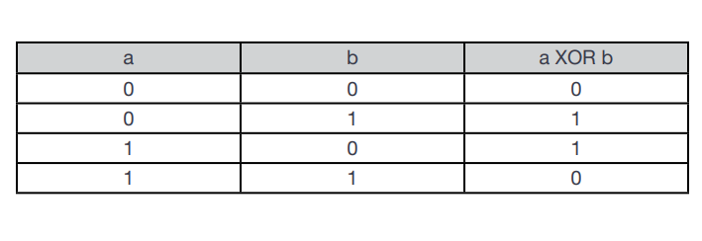

Slide 5
One-Time Pad: Decryption
e=000 h=001 i=010 k=011 l=100 r=101 s=110 t=111
Decryption: Ciphertext ⊕ Key = Plaintext
s | r | l | h | s | s | t | h | s | r
110 | 101 | 100 | 001 | 110 | 110 | 111 | 001 | 110 | 101
Ciphertext:
111 | 101 | 110 | 101 | 111 | 100 | 000 | 101 | 110 | 000
001 | 000 | 010 | 100 | 001 | 010 | 111 | 100 | 000 | 101
h | e | i | l | h | i | t | l | e | r
Key:
Plaintext:

Slide 6
One-Time Pad 2
This technique is to combine the key and the message using modular addition
The numerical values of corresponding message and key letters are added together, modulo 26.
So, if key is XMCKL and the message is hello, then the coding would be done as follows:

Slide 7
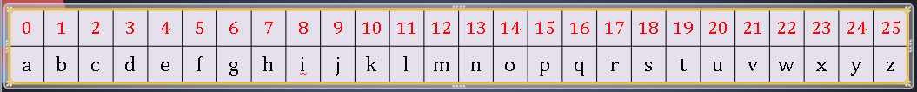
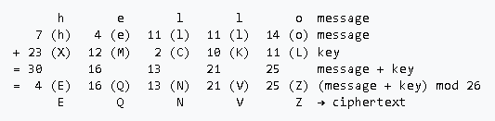
One-Time Pad 2 (Encryption)

Slide 8
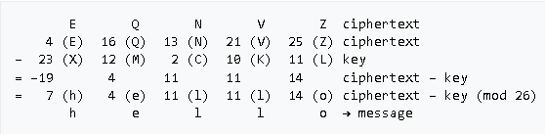
One-Time Pad 2 (Decryption)

Slide 9
Vigenère Tableau Cipher
A set of substitution rules consists of the 26 Caesar ciphers, with shifts of 0 through 25.
Given a key letter x and a plaintext letter y, the ciphertext letter is at the intersection of the row labeled x and the column labeled y; in this case the ciphertext is V.

Slide 10
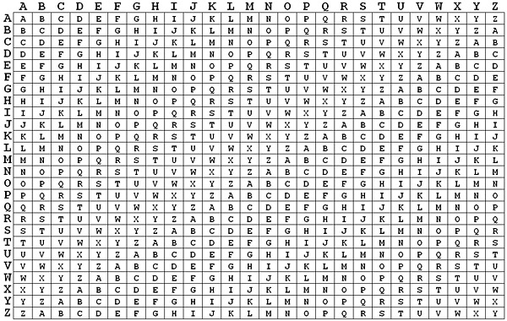
Vigenère Tableau Cipher

Slide 11
Vigenère Tableau Cipher: Example Encryption
To encrypt a message, a key is needed that is as long as the message. Usually, the key is a repeating keyword.
For example, if the keyword is deceptive, the message "we are discovered save yourself" is encrypted as follows:
key: deceptivedeceptivedeceptive
plaintext: wearediscoveredsaveyourself
ciphertext: ZICVTWQNGRZGVTWAVZHCQYGLMGJ

Slide 12
Vigenère Tableau Cipher: Example Decryption
Decryption is equally simple.
The key letter again identifies the row.
The position of the ciphertext letter in that row determines the column, and the plaintext letter is at the top of that column.

Slide 13
Affine cipher
The affine cipher is a type of substitution cipher, where each letter in an alphabet is mapped to its numeric equivalent, encrypted using a simple mathematical function, and converted back to a letter.
Each letter is enciphered with the function
C= (ax + b) mod m
where modulus m is the size of the alphabet and a and b are the keys of the cipher.

Slide 14
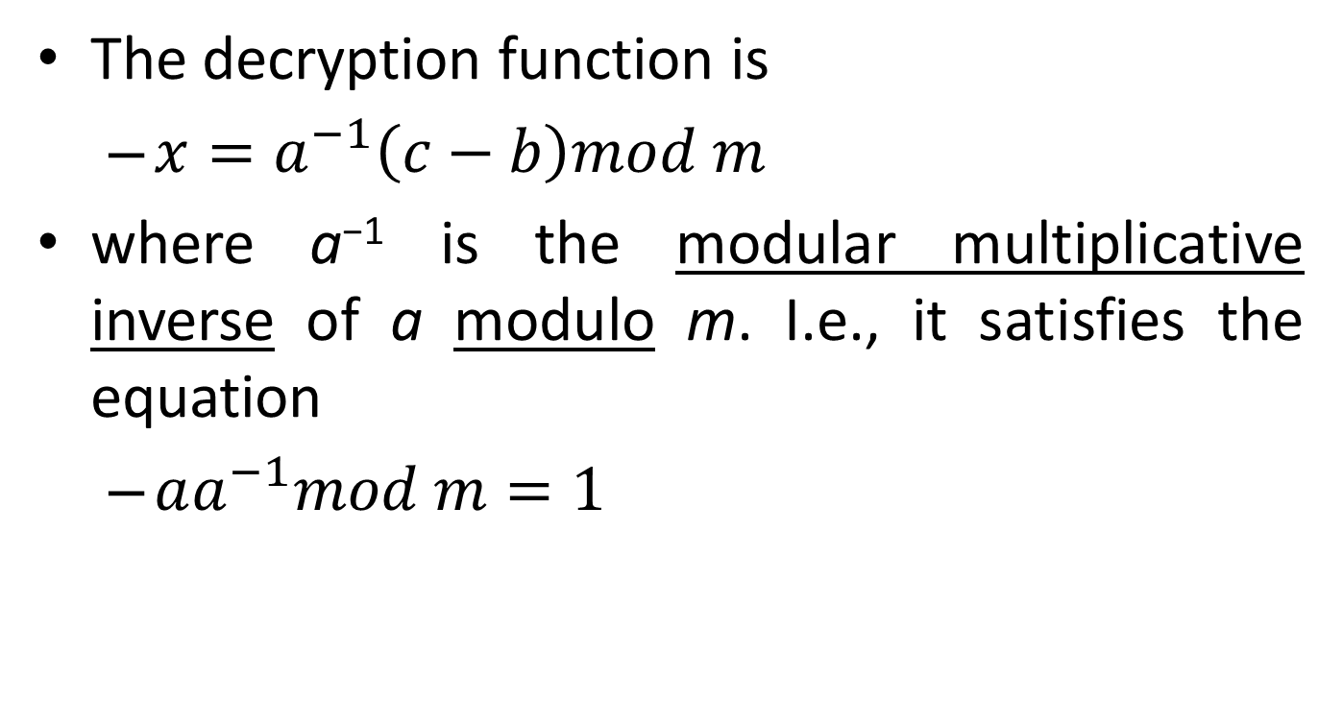
Affine cipher Decryption
The decryption function is
$x=a^{−1}\left(c−b\right)mod m$
where a⁻¹ is the modular multiplicative inverse of a modulo m. I.e., it satisfies the equation
$aa^{−1}mod m=1$

Slide 15
Affine cipher: Example Encryption
The plaintext to be encrypted is "AFFINE CIPHER“, taking a to be 5, b to be 8, and m to be 26 since there are 26 characters in the alphabet being used.
Only the value of a has a restriction. The possible values that a could be are 1, 3, 5, 7, 9, 11, 15, 17, 19, 21, 23, and 25.
The value for b can be arbitrary as long as a does not equal 1 since this is the shift of the cipher.
Thus, the encryption function for this example will be
C= (5x + 8) mod 26.

Slide 16
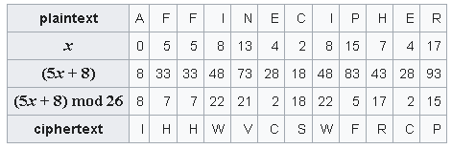
Affine cipher: Example Encryption

Slide 17
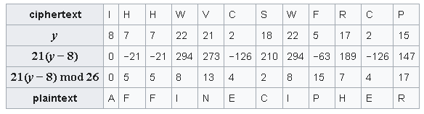

Affine cipher: Example Decryption
The decryption function is
x= 21(y − 8) mod 26
where a⁻¹ is calculated to be 21, and b is 8.
$5{(a}^{−1})mod 26=1$

Slide 18
Affine cipher: Example 2 Encryption
Encrypt the plaintext “sail” using an affine cipher with encryption key (3,7)
s → 18 → 3 · 18 + 7 ≡ 9 (mod 26) → J
a → 0 → 3 · 0 + 7 ≡ 7 (mod 26) → H
i → 8 → 3 · 8 + 7 ≡ 5 (mod 26) → F
l → 11 → 3 · 11 + 7 ≡ 14 (mod 26) → O

